Slide 1
Team Leadership
Prof. Koliya pulasinghe

Slide 2
Agenda
What is leadership?
Identify the traits and skills of an effective leader
Key leadership theories
Examine the role, duties and responsibilities of a Team Leader
Understand the limits of authority in a Team Leader role
Develop a plan to develop your own leadership potential
Most parts of this lecture is taken from University of Exeter, UK – Leadership Skills module

Slide 3
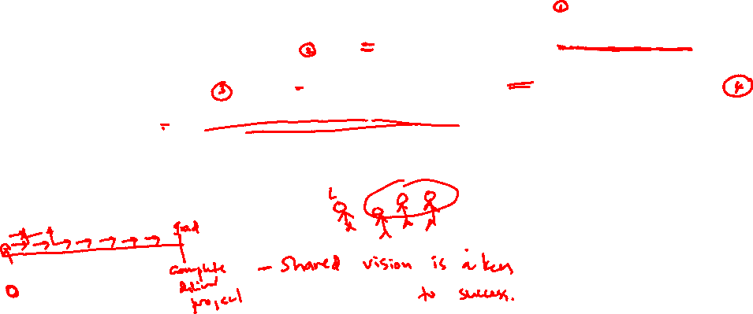
What is Leadership?
"Leadership is a function of knowing yourself, having a vision that is well communicated, building trust among colleagues, and taking effective action to realize your own leadership potential."
Prof. Warren Bennis

Slide 4
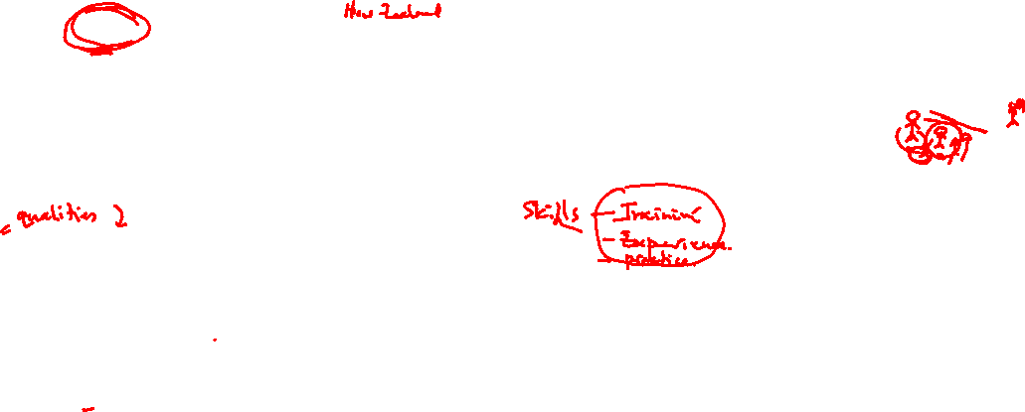
Leadership Theories
Early Theories:
Great Man Theories
Leaders are exceptional people, born with innate qualities, destined to lead
Term 'man' was intentional - concept was primarily male, military and Western
Trait Theories
Research on traits or qualities associated with leadership are numerous
Traits are hard to measure. For example, how do we measure honesty or integrity?

Slide 5
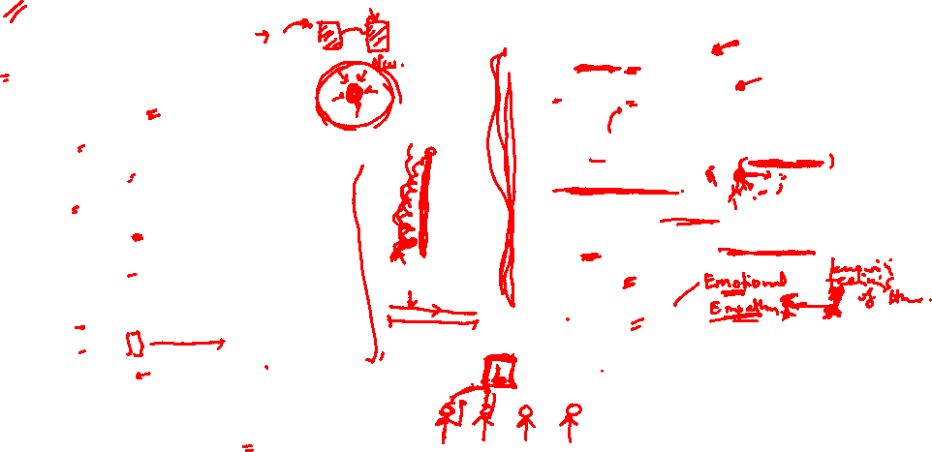
Leadership Traits and Skills
Traits
Adaptable to situations
Alert to social environment
Ambitious and achievement orientated
Assertive
Cooperative
Decisive
Dependable
Dominant (desire to influence others)
Energetic (high activity level)
Persistent
Self-confident
Tolerant of stress
Willing to assume responsibility
Skills
Clever (intelligent)
Conceptually skilled
Creative
Diplomatic and tactful
Fluent in speaking
Knowledgeable about group task
Organised (administrative ability)
Persuasive
Socially skilled
Stogdill, 1974
Leaders will also use:
Integrity, Honesty, Compassion, Humility

Slide 6
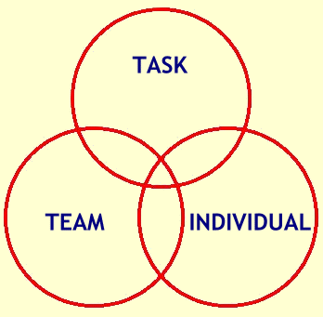
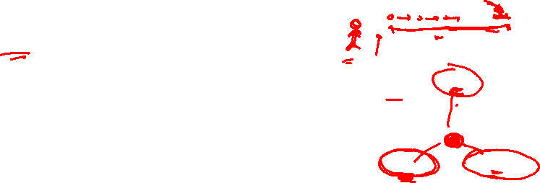
Leadership Theories
Functional Theories (John Adair, Action Centred Leadership, 1970)
Leader is concerned with the interaction of 3 areas:
Task – goal setting, methods and process
Team – effective interaction/communication, clarify roles, team morale
Individual – attention to behaviour, feelings, coaching, CPD

Slide 7

Leadership Theories
Behaviourist Theories (Blake and Mouton, Managerial grid, 1964)
Leaders behaviour and actions, rather than their traits and skills e.g. production orientated or people orientated
Different leadership behaviours categorised as ‘leadership styles’ e.g. autocratic, persuasive, consultative, democratic
Doesn’t provide guide to effective leadership in different situations

Slide 8
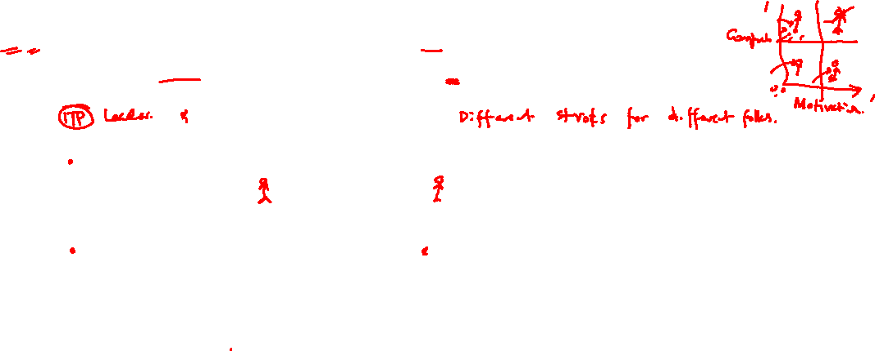
Leadership Theories
Situational/contingency Leadership (Hersey-Blanchard, 1970/80) Leadership style changes according to the 'situation‘ and in response to the individuals being managed – their competency and motivation
Competency | Low competence | Some competence | High competence | High competence
Motivation | Low commitment/ Unable and unwilling or insecure | Variable commitment/ Unable but willing or motivated | Variable commitment/ Able but unwilling or insecure | High commitment/ Able and willing or motivated
Leadership style | DIRECTIVE (Telling) | COACHING (Selling) | SUPPORTIVE (Participating) | DELEGATORY (Observing)

Slide 9
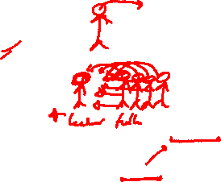
Leadership Theories
Transformational Theory (Bass and Avolio, 1994)
Leaders inspire individuals, develop trust, and encourage creativity and personal growth
Individuals develop a sense of purpose to benefit the group, organisation or society. This goes beyond their own self-interests and an exchange of rewards or recognition for effort or loyalty.

Slide 10
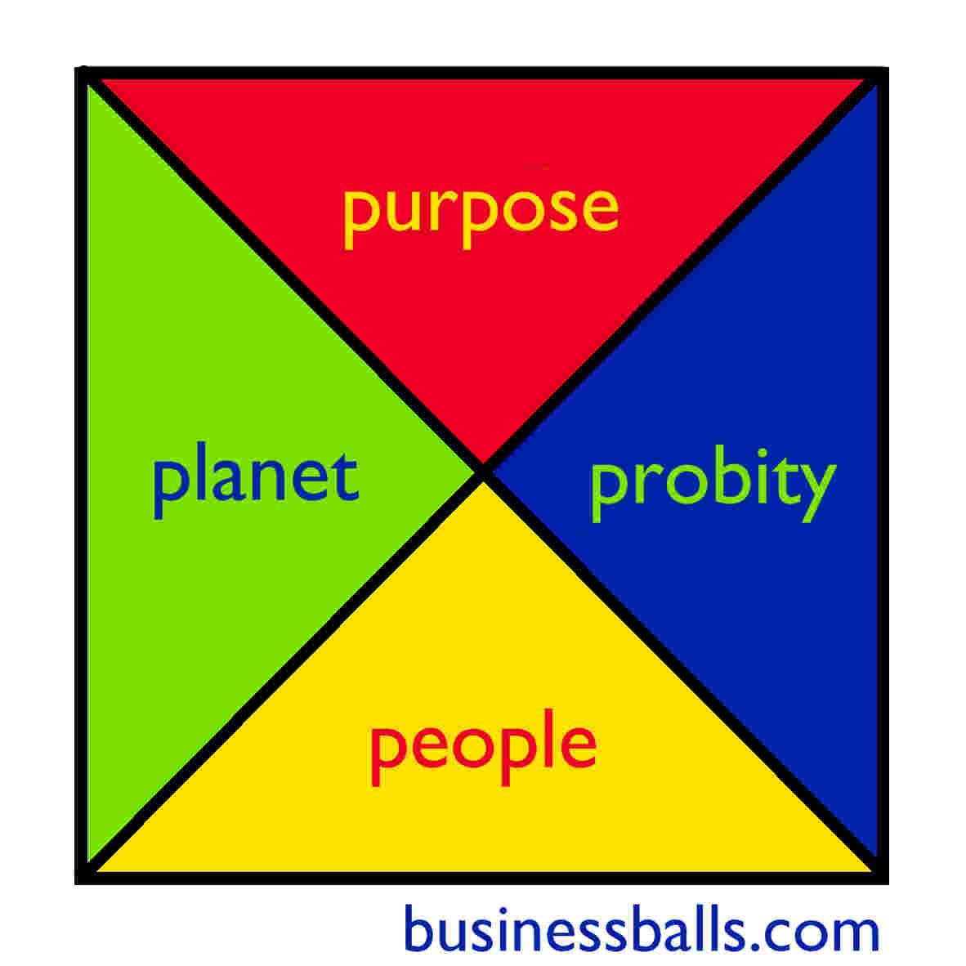
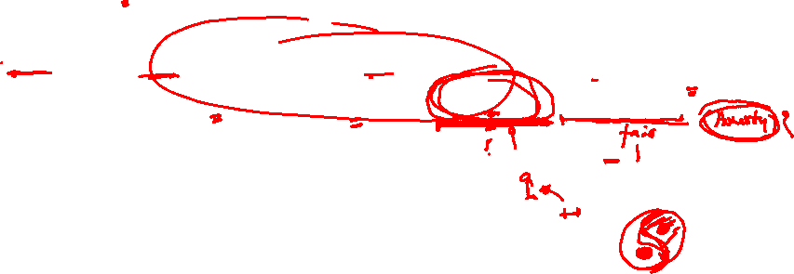
Leadership Theories
Ethical Leadership (Alan Chapman, 2006)
CSR, sustainability, equality, humanitarianism
Four P’s - Purpose, People, Planet, Probity

Slide 11
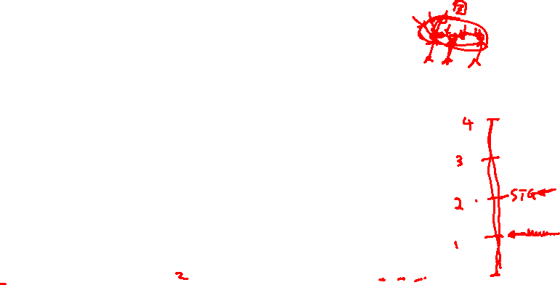
Key Team Leader Responsibilities
Guide/coordinate team members – encourage teamwork and motivate individuals
Provide structure for team – set mission and purpose, clarify roles and responsibilities, allocate tasks and set objectives
Clarify working methods, practises and protocol
Focus on performance – anticipate challenges, monitor performance, delegate and provide CPD support

Slide 12

Accountability, Responsibility, and Authority
Accountability the state of being accountable, liable, or answerable
Responsibility (for objects, tasks or people) can be delegated but accountability can not – buck stops with you!
A good leader accepts ultimate responsibility:
will give credit to others when delegated responsibilities succeed
will accept blame when delegated responsibilities fail
Accountability can not operate fairly without the leader being given full authority for the responsibilities concerned
Authority is the power to influence or command thought, opinion or behaviour
Cross-functional team – less authority - more difficult to manage

Slide 13
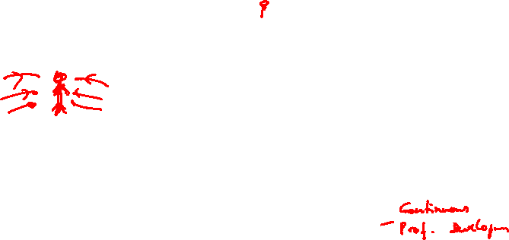
How to improve your leadership skills
Reflect and identify the skills YOU need to lead effectively and create your action plan to develop them
Ask for feedback from work colleagues, line managers, tutors, your ‘followers’
Practise! Take on responsibility (work, volunteering, clubs & Societies) and reflect on your performance
Find a mentor – learn from positive leadership role-models
Attend further leadership and management training

Slide 14

Review your performance as a leader
Exercise:
Assess yourself as a Leader
Conduct a SWOT analysis - Strengths, Weaknesses, Opportunities, Threats
Develop an Action Plan to improve as a leader
list 2 actions you will undertake to address Weaknesses or capitalise on Opportunities identified
Apply SMART targets to your actions – Specific,
Measurable, Achievable, Realistic, Time-bound
3. Write a reflective journal about one of the Leadership experiences you faced with a team or in your life
Submit your assignment on or before midnight 9th March, 2021 (Next Tuesday).

